Slide 1
Computational Physics
(Lecture 2)
PHY4061

Slide 2
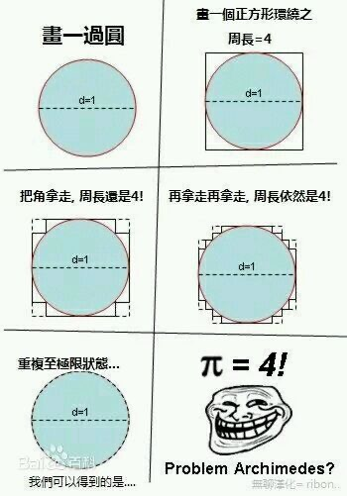
Good approximation vs. bad approximation
    One example of a bad simulation.
    What went wrong?
    Could it become a good approximation?
    Good approximation is good physics.

Slide 3
Random processes

Slide 4
Random number generation
Randomness
  a property of an infinite sequence
    x_{i} with i = 1, 2, . . . .
    Impossible to tell whether a single number is random or not.
    A negative property, it is the absence of any order.
    Can we truly test certain sequence of data is random or not?
Uniform distribution
  Uniformly distributed in the range of (0,1) or (1, 2^{M})
  The prediction of a very smart person is not better than average.
    Rock paper scissor game.
    John Nash’s equilibria: a mix of strategies always exists where no single player can do any better by changing their own strategy alone.
    https://www.quantamagazine.org/the-game-theory-math-behind-rock-paper-scissors-20180402/
Question: Are there game without Nash’s equilibria?
Question: Can you generate true random numbers using a computer?

Slide 5
Desired properties of random numbers
Determinism.
  odd property for a random sequence
    if it is deterministic, one can predict with certainty the next number, if you know the algorithm.
    Useful property for debugging!
    Computers as they are now constructed are deterministic.
    The only possibilities for randomness are to read an "external" device,
      the microsecond clock or a very unreliable memory.
    This is not done
      too slow and too expensive.
      Any other problems for such random numbers?

Slide 6
Russian mathematician Ilya M. Sobol:
"A random variable that satisfactorily describes a physical quantity in one type of phenomenon may prove unsatisfactory when used to describe the same quantity in other phenomena".
Question: any other ways to generate random numbers, instead of reading external devices or using pseudo random number generators?

Slide 7
Tables of Random Numbers
Very simple
Just like shuffling cards.
Suppose: you write each number from 0 to 99 on a card,
put all the cards in a hat
shake it and draw all the cards from this hat one by one
you end up with a sequence of 100 random numbers.

Slide 8
To use these numbers in a program,
you can store them in memory
  the same order in which they were picked from the hat
  create a global variable to keep track the next random number that can be used from that table.
  Problems of this method?

Slide 9
Simple code:
short rand[100] = {16, 55, 30, 12, 3, 92, ... };
int counter = 0;
int N = 32;
for (int i = 0; i < N; ++i) {
short randNumber = rand[counter++];
...
}

Slide 10
In 1955, Rand Corporation released a sequence of 1 million random digits.
It is the longest sequence of random numbers ever published!
  Also probably the most boring book ever.

Slide 11
Introduction to Crystal structure
Reference books: Any solid state physics text books, Kittel’s or Kun Huang’s for example.

Slide 12
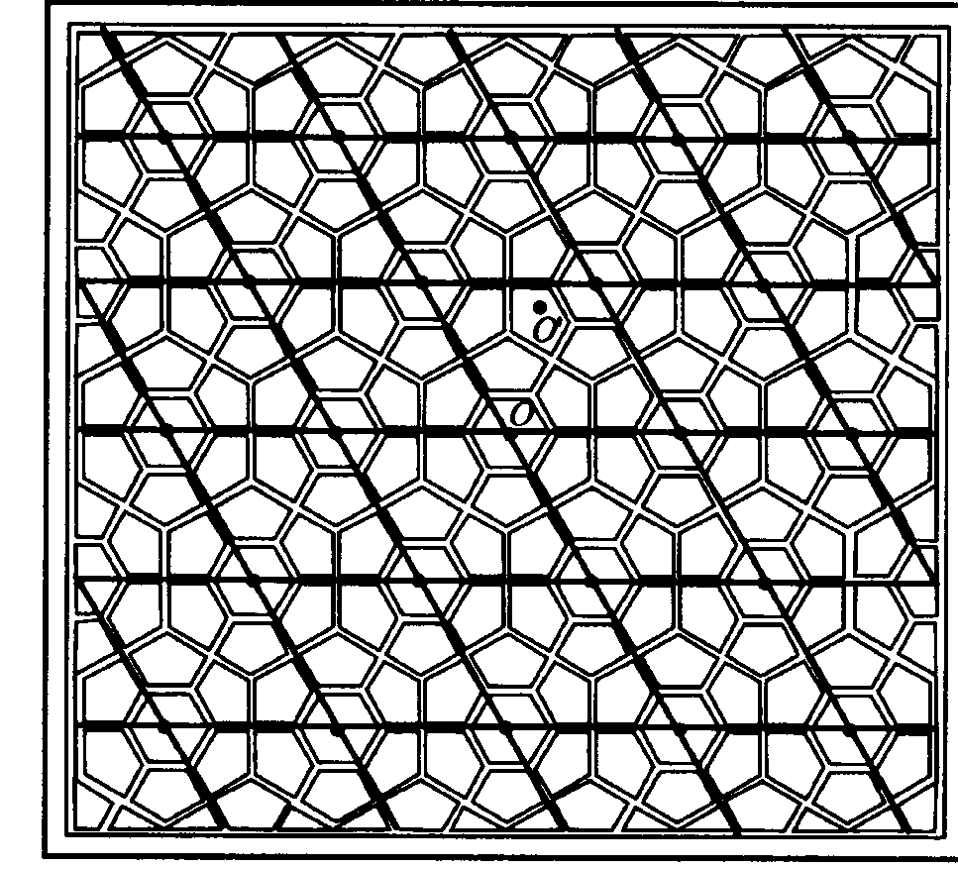
Crystal structure
Periodically placed building blocks (atoms, molecules, ions…)
  Translational symmetry of the basis
  Proved by X-ray
  diffractions
Crystal: basis + lattice
  Or basis in the
  primitive cell + Bravais lattice
Why many high quality
solid samples have long
range ordering at low
temperature?

Slide 13
Bravais Lattices
A regular periodic arrangement of points in space.
  tn=n1t1+n2t2+n3t3
  t1, t2,t3: primitive vectors
  n1, n2, n3: integers
  t1, t2, t3 form primitive cells.
  Volume of primitive cell:
    V= t1∙(t2xt3)
  Right handed system
  The primitive cell contains one lattice point, smallest cell
Question: The choice of the primitive vectors is unique or not?

Slide 14
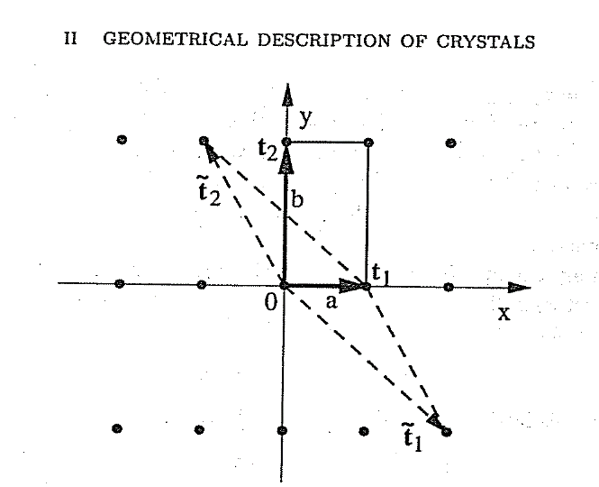
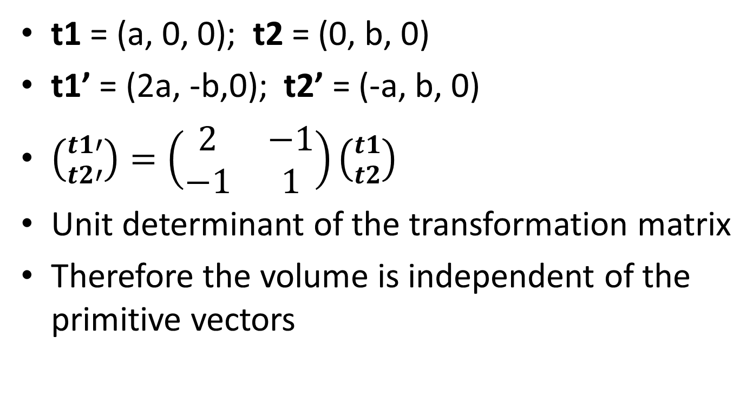
The choice of the primitive vectors is unique or not?
t1 = (a, 0, 0); t2 = (0, b, 0)
t1’ = (2a, -b,0); t2’ = (-a, b, 0)
$\left({t1′ \atop t2′}\right)=\left(\begin{matrix}2 & −1 \\ −1 & 1\end{matrix}\right)\left({t1 \atop t2}\right)$
Unit determinant of the transformation matrix
Therefore the volume is independent of the primitive vectors

Slide 15
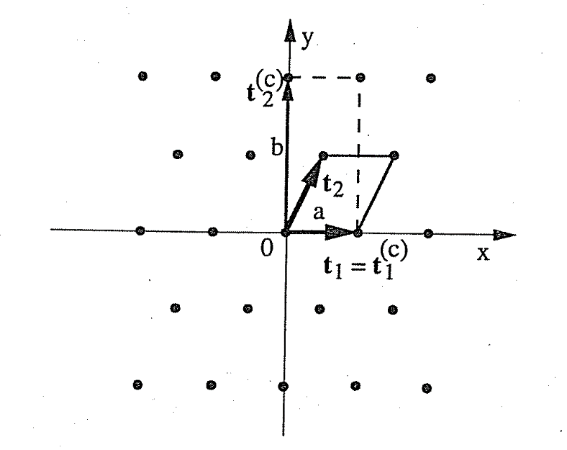
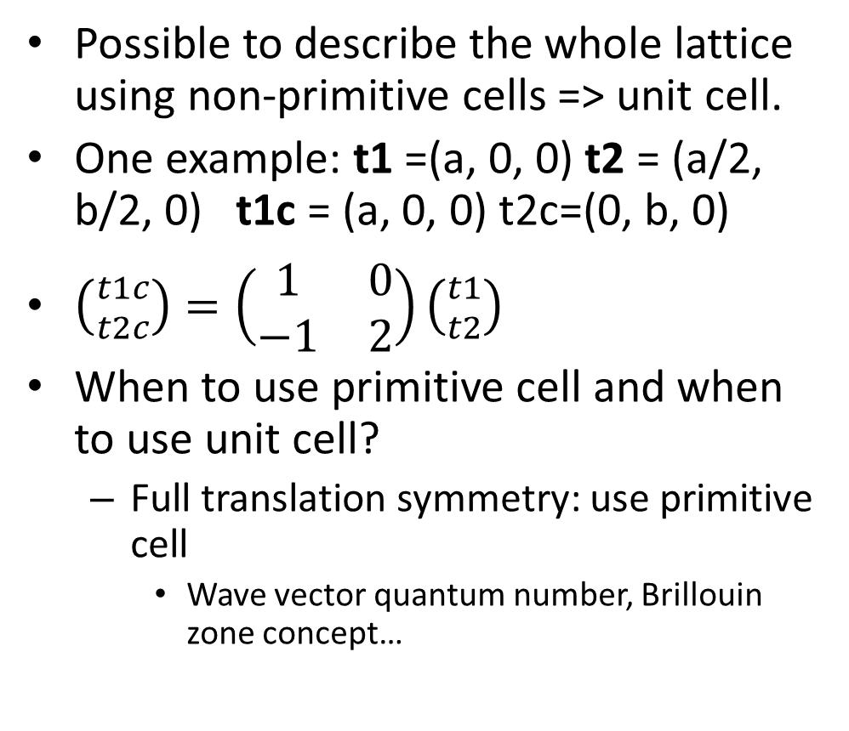
Unit Cell
Possible to describe the whole lattice using non-primitive cells => unit cell.
One example: t1 =(a, 0, 0) t2 = (a/2, b/2, 0) t1c = (a, 0, 0) t2c=(0, b, 0)
$\left({t1c \atop t2c}\right)=\left(\begin{matrix}1 & 0 \\ −1 & 2\end{matrix}\right)\left({t1 \atop t2}\right)$
When to use primitive cell and when to use unit cell?
  Full translation symmetry: use primitive cell
    Wave vector quantum number, Brillouin zone concept…

Slide 16
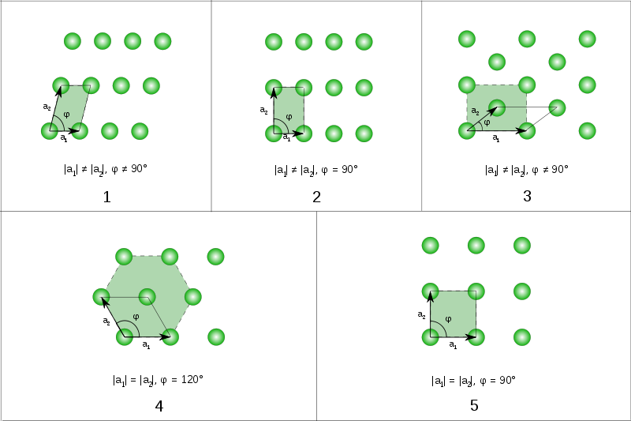
1 oblique (1, 2), 2 rectangular (1m 2mm) including 3 centered rectangular (rhombic) , 4 hexagonal (3, 3m, 6, 6mm) , 5 square (4, 4m)

Slide 17
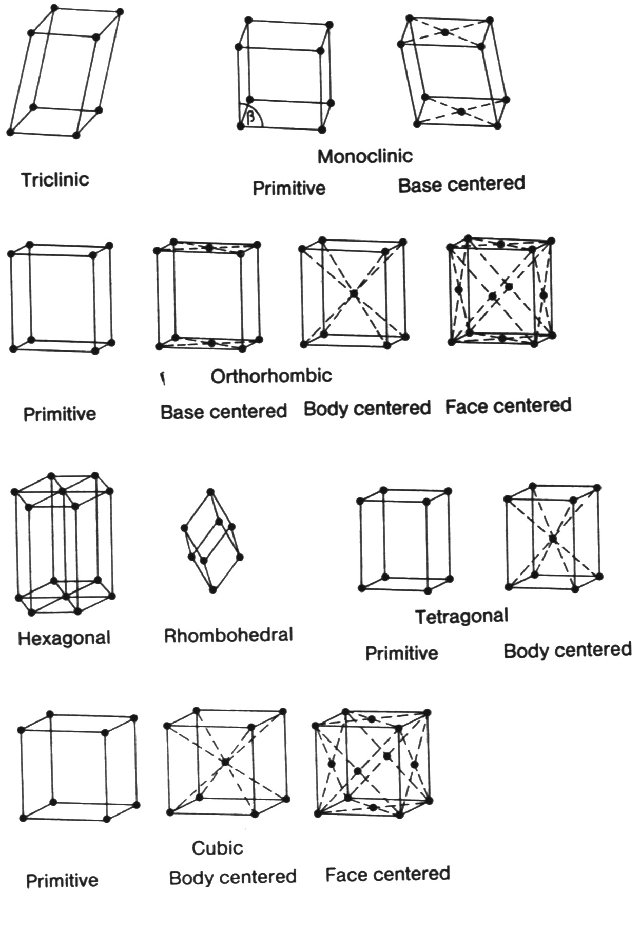

Slide 18
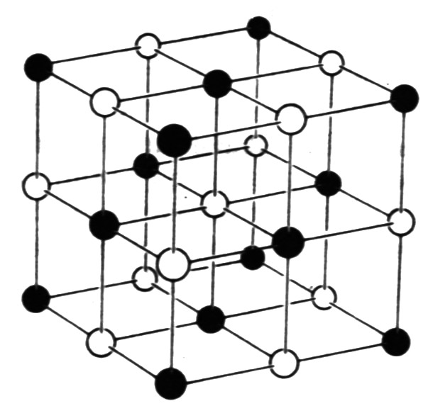
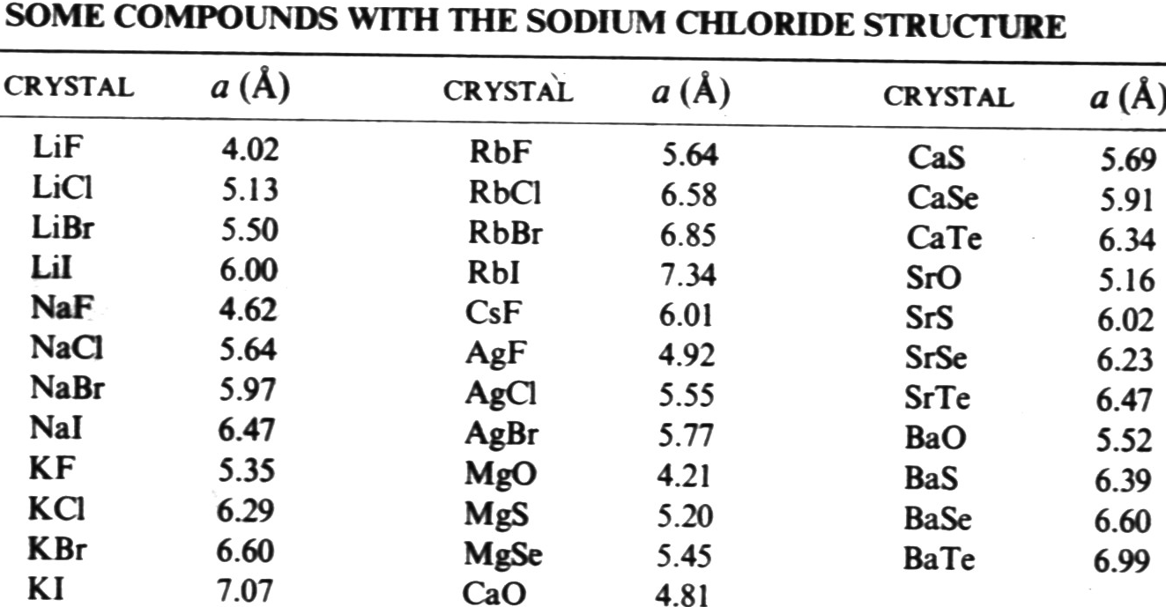
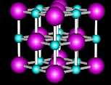

Slide 19
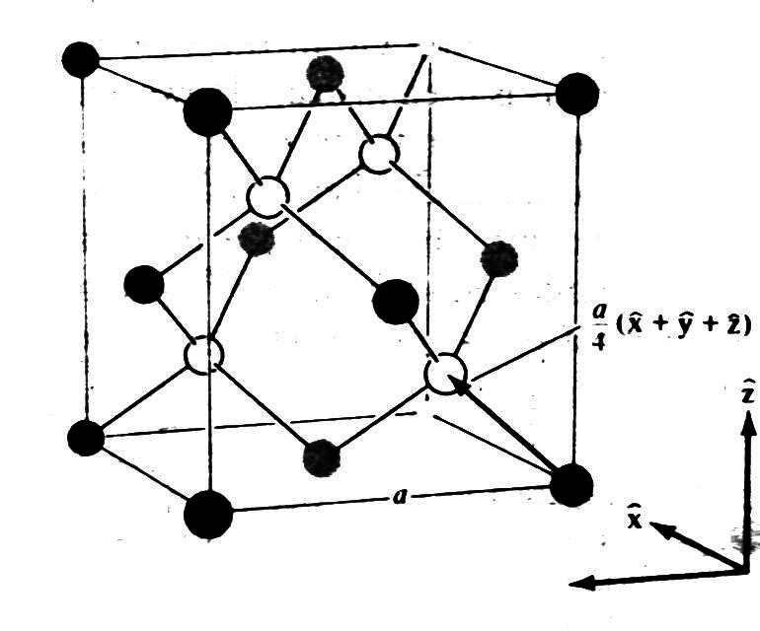
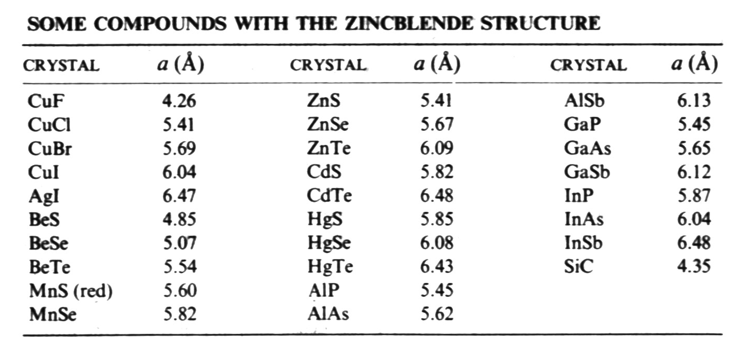
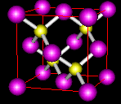
Diamond and Zincblende

Slide 20
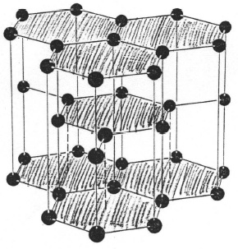
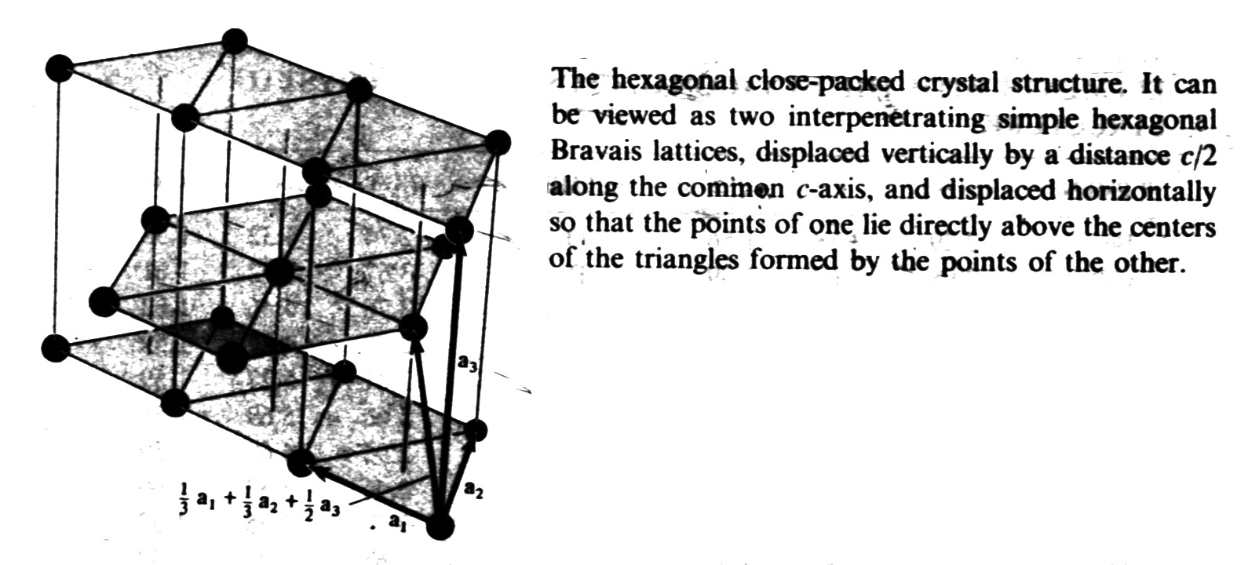
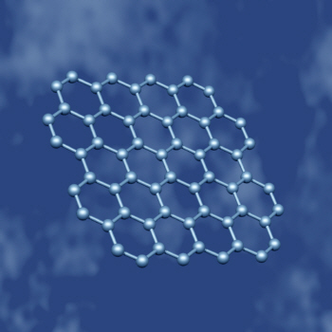
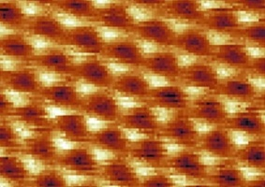
ABABAB stacking
Packing fraction: the maximum ratio of the volume of hard balls that occupy the lattice points to the total volume
Graphene (Scienc 306,666,2004)

Slide 21
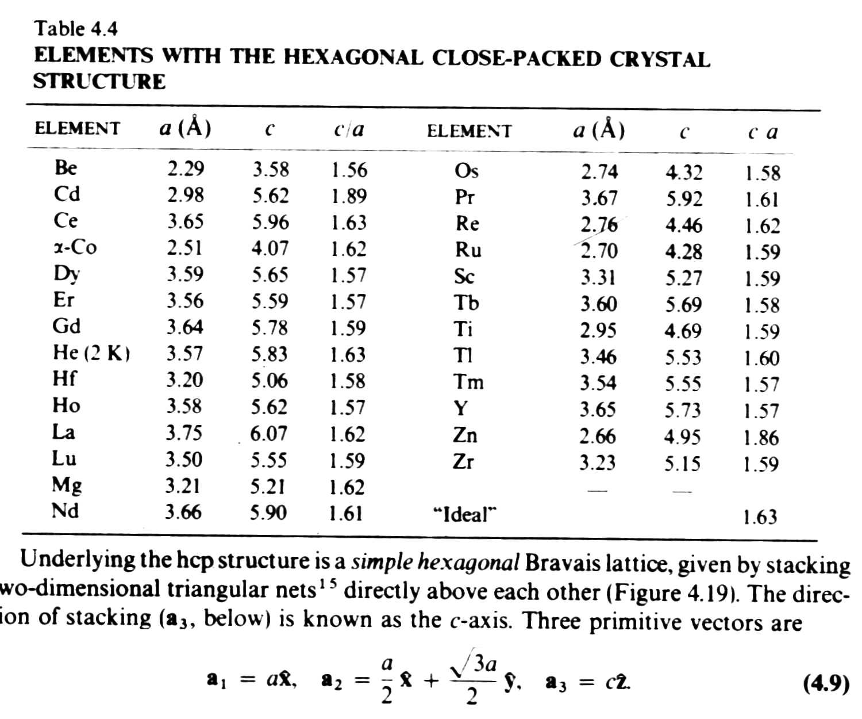

Slide 22
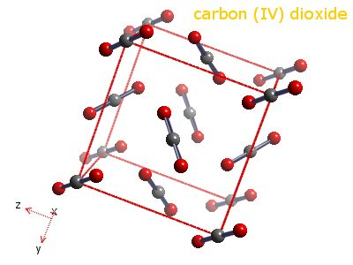

Slide 23
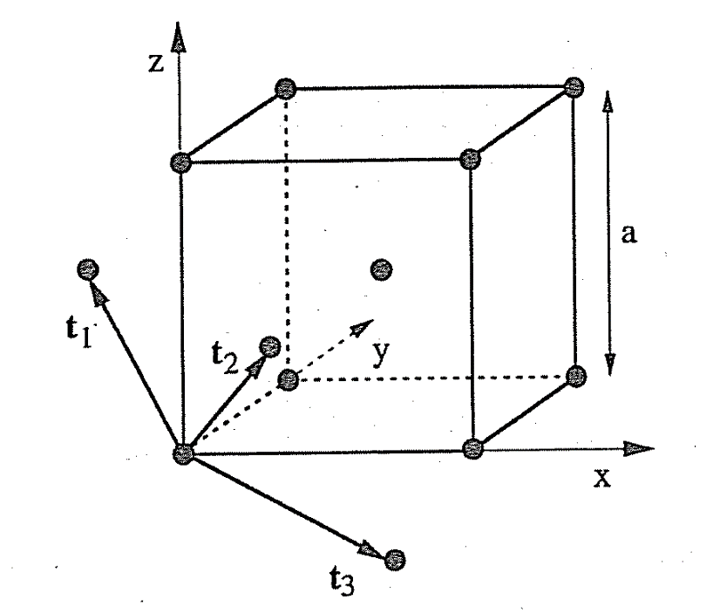
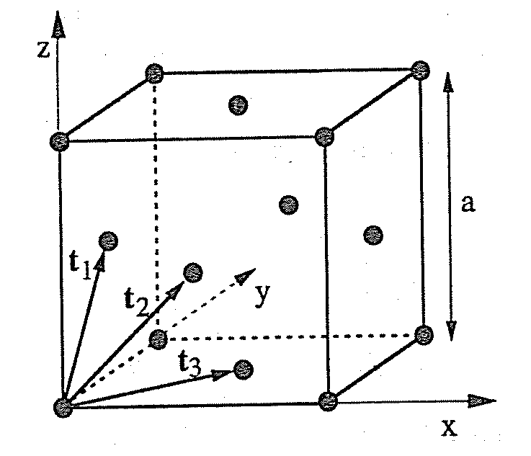
Geometrical description and primitive cell
of some crystal structures
Fcc: t1 = a/2(0,1,1) t2= a/2(1,0,1) t3=a/2(1,1,0)
Bcc: t1 = a/2(-1,1,1) t2= a/2(1,-1,1) t3=a/2(1,1,-1)

Slide 24
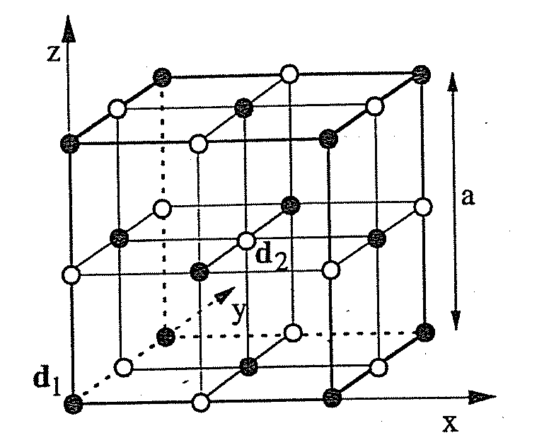
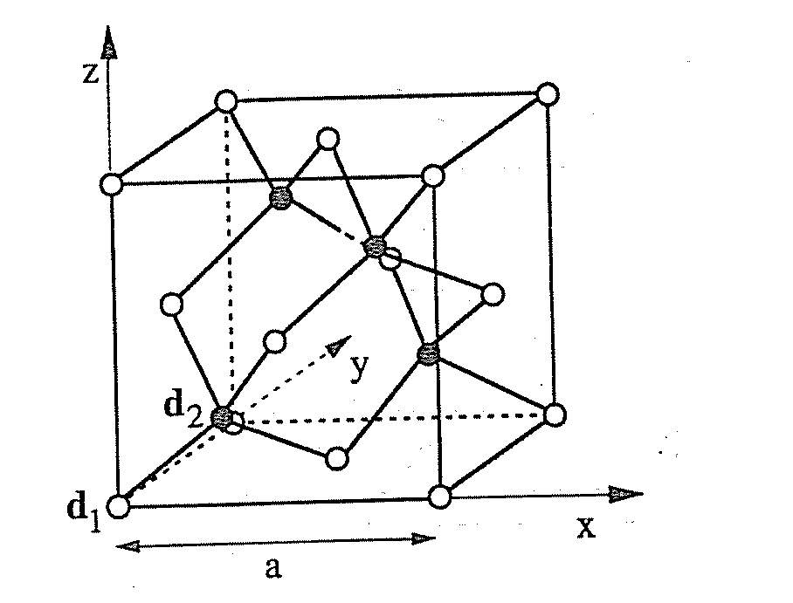
NaCl: t1 = a/2(0,1,1) t2= a/2(1,0,1) t3=a/2(1,1,0), d1 = 0, d2 = a/2(1,1,1)
Diamond structure and zincblende structure
t1 = a/2(0,1,1) t2= a/2(1,0,1) t3=a/2(1,1,0), d1 = 0, d2 = a/4(1,1,1)

Slide 25
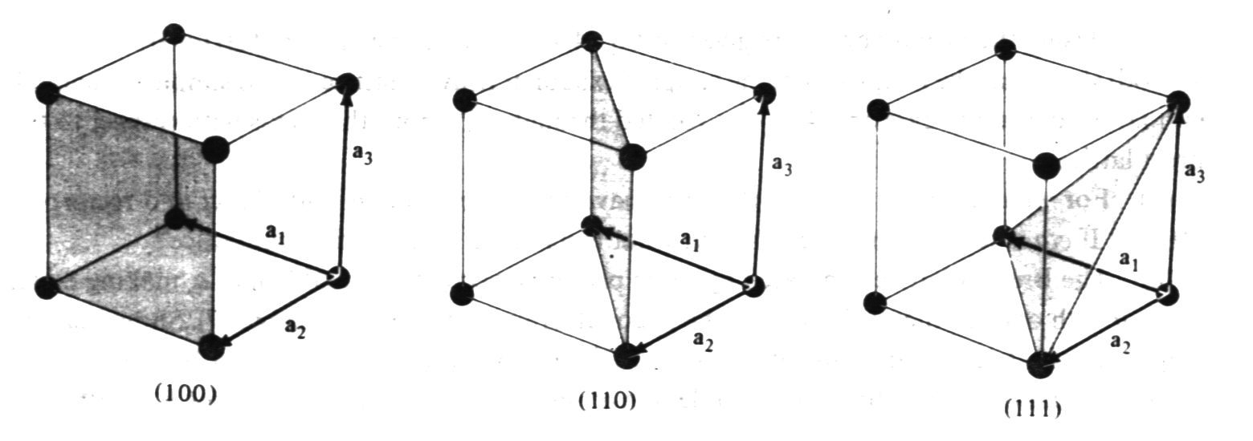

Crystal direction： [l₁,l₂,l₃] l₁ a₁+l₂ a₂+l₃ a₃
equivalent: <l₁l₂l₃>
By convention, negative index are written with a bar, as in $\overline{3}$ for −3
Crystal planes (h₁,h₂,h₃) ：Miller index
a₁/ h₁， a₂/ h₂，a₃/ h₃.
equivalent {h₁,h₂,h₃}
a₁ a₂ a₃ are unit cell vectors!

Slide 26
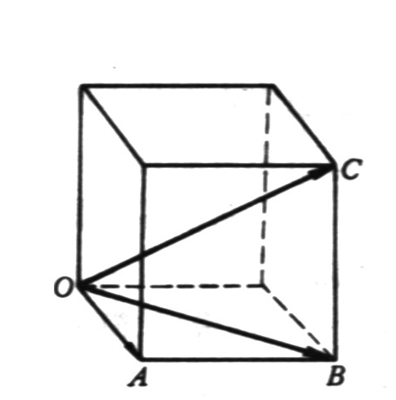
Crystal direction for a simple cubic

Slide 27
Sample code for a simple cubic lattice
Input: cell size (L_{x} ´ L_{y} ´ L_{z}) = (n_{x} ´ n_{y} ´ n_{z})a³ , a --- lattice constant.
Sc: Na = 0 (no. of atoms)
i=1, n_{x}
j=1, n_{y}
k=1, n_{z}
Na = Na +1
x(Na) = 0.0 + (i-1)*a
y(Na) = 0.0 + (j-1)*a
z(Na) = 0.0 + (k-1)*a
Next k
Next j
Next i
Nt(Sc) = Na (total no. of Sc atoms)

Slide 28
Project A part I: Programming Sc, Bcc, Fcc, and Diamond crystalline structures.
Detailed requirements:
The simulation cell size is adjustable in both periodicity and lattice constant. The shape of the cell has to be cubic like (or tetragonal). Make sure to include correct number of atoms in your cell. Plot the structure using any graphic software, like VMD…
Score will be deducted if the program has bad variable/function naming conventions or without adequate comments. Email the code and output to Wenjing directly.
Project is due two weeks after the lab. Score will be deducted if the submission is late.

